Slide 1
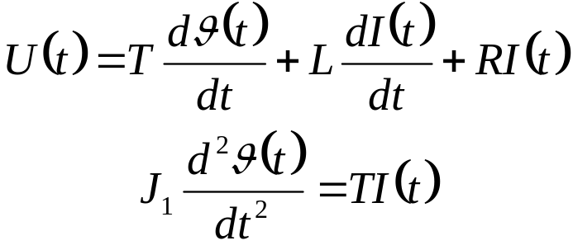

State Space Model
This is an engineering meeting. Therefore some technical basics first.
How does a model look like?
A simple galvo example!
Notes:
This type of filter removes all frequency components above a given bandwidth and leaves the low frequencies alone.

Slide 2
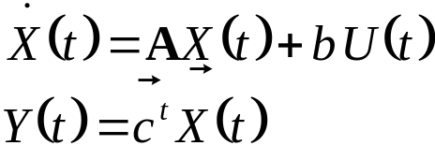
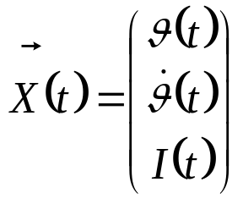
State Space Model
Why does the technology is called state space?
Notes:
This type of filter removes all frequency components above a given bandwidth and leaves the low frequencies alone.

Slide 3
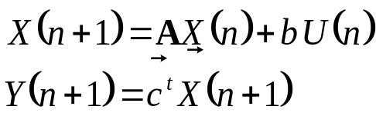
State Space Model
Why does the technology is called state space?
This equation can be solved for a discrete constant time interval where U(t) is constant as well,
thus forming the discrete state space model.
Notes:
This type of filter removes all frequency components above a given bandwidth and leaves the low frequencies alone.

